Slide 1
Starcraft 2
Team 3
Neehar Namjoshi, Nishita Rao, Pooja Shah, Shivam Kumar

Slide 2
Table of Contents
Introduction
Exploration of Data
Model Comparison
Business Recommendation
Appendix

Slide 3
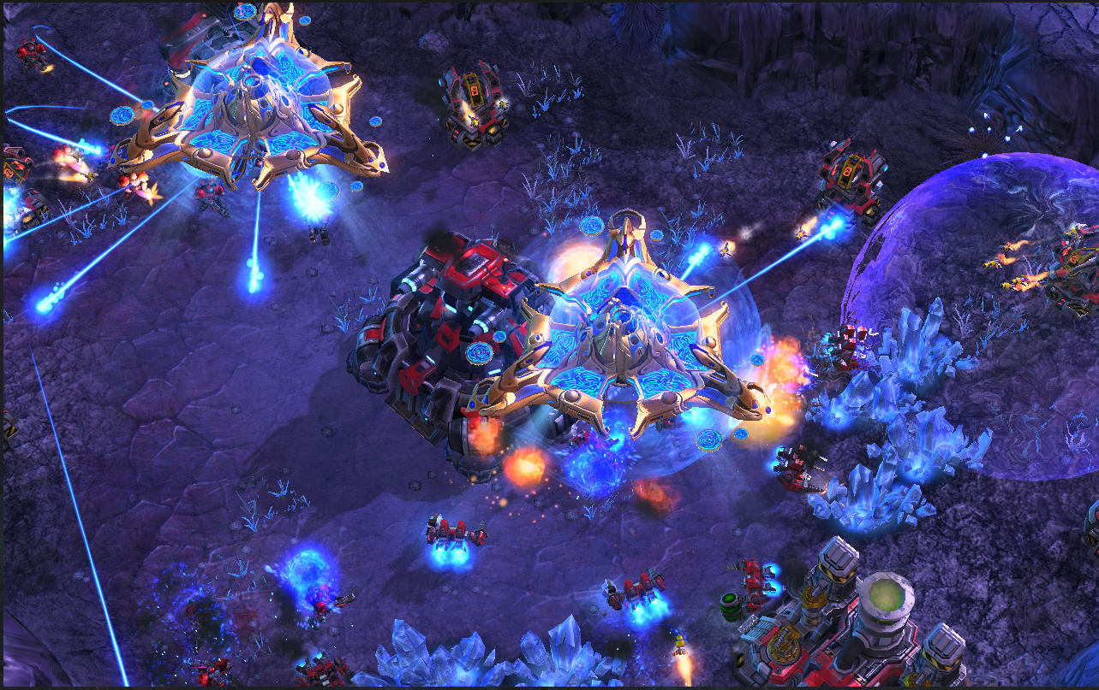
Introduction
Starcraft 2 is a Real-Time Strategy (RTS) game
1v1 for professional tournaments
Continuous not turn-based
20 x 3396
Target Variable: Finding the highest skill level players

Slide 4
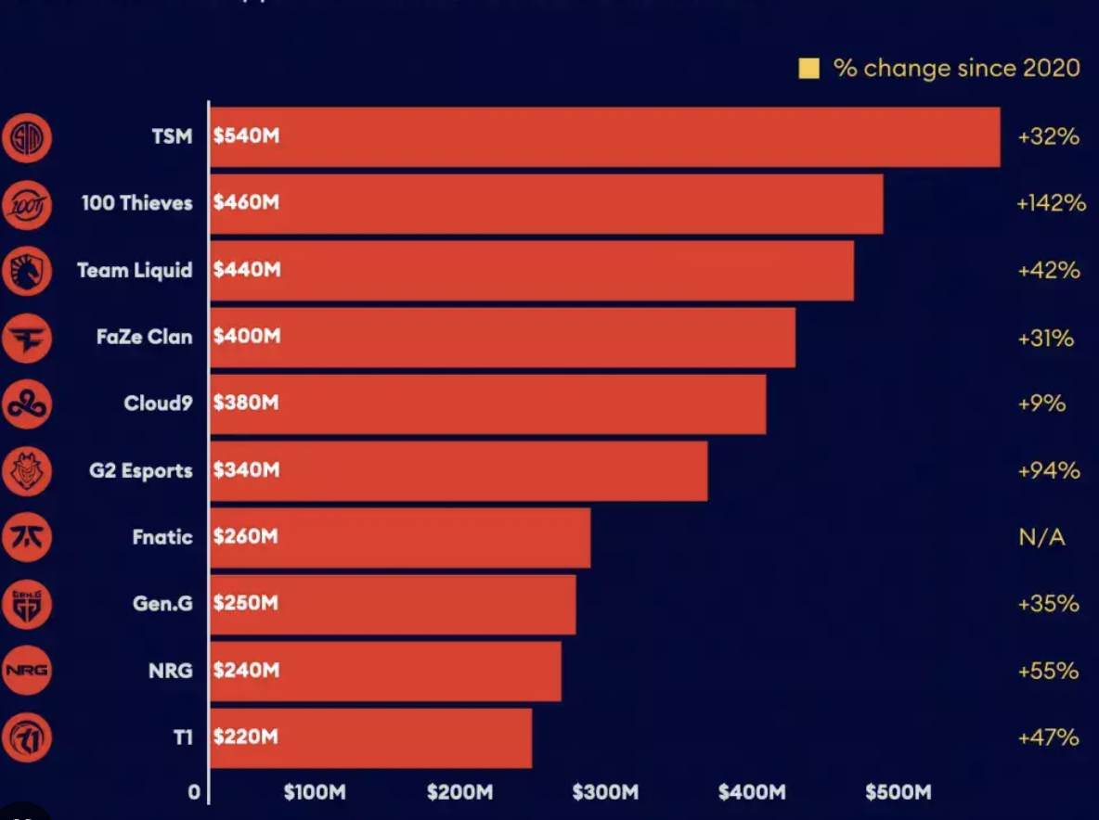

Business Case
Why do we want to find the best SC2 players for Electronic Sports Teams?
Esports Industry Valuation at $3.5billion (22% Growth)
Prize Pool
Sponsors
Recognition
Merchandise Sales

Slide 5

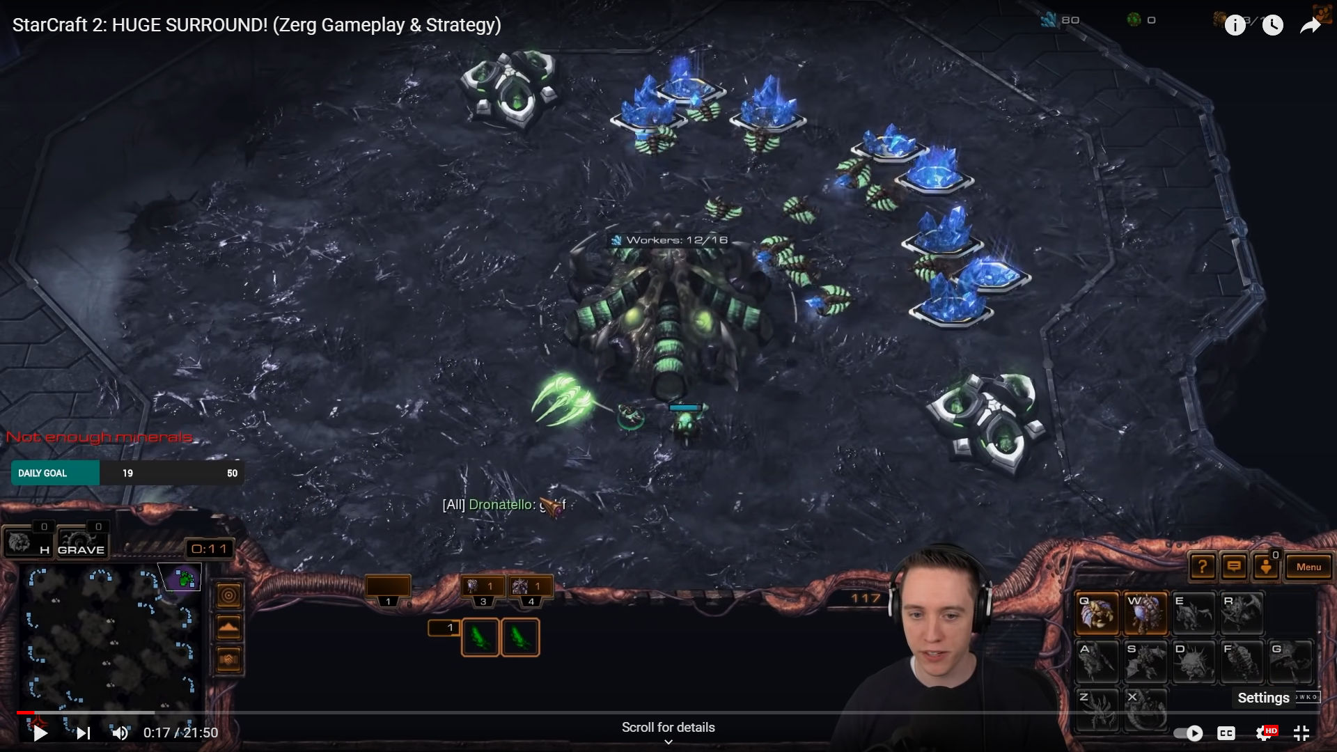
Breaking down the Dataset
1 timestamp = 1/88.5 seconds = 11.3 milliseconds
Action : mouse-click or keystroke
Hotkey : a key or combination of keys for quick access (eg. Ctrl + S)
Variables
SelectByHotkeys
AssignToHotkeys
UniqueHotkeys
MinimapAttacks
No. of actions per time stamp
UniqueUnitsMade
ActionLatency
GapBetweenPACs
Hotkeys
Minimap
Units

Slide 6
Breaking down the Dataset (Contd.)
Variables
ActionLatency
GapBetweenPACs
What is Perception Action Cycle (PAC) ?
Example: starcraft two team three
star craf ttwo team thre
Action Latency
GAPBetweenPACs
PAC 1
PAC 2
PAC 3
PAC 4
PAC 5

Slide 7
Exploration of Data
Exploring Variables
Verifying data type of variables in data set
Changes to target variable
Determining non-relevant variables
Significant Predictors
Checking for statistical significance
Assessing correlations between predictors
1
5
2
Missing Data
Undertaking checks throughout dataset
Reducing Dimensionality
Interaction terms
4
3
Outliers
Reviewing distribution of predictor variables
Transformation of key variables
Notes:
What variables appear important?
What trends or patterns have you identified that are relevant to the business problem?
What interesting variable relationships have you discovered? Include visualizations to support your observations.

Slide 8
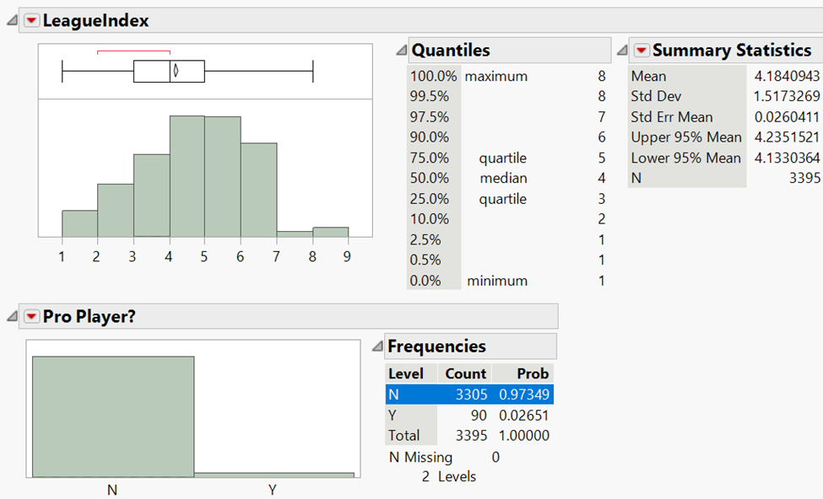
Exploring Variables
01
Properties of Predictor Variables
Checks for data types of predictor variables
02
Recategorization of Target Variable
Creation of Pro Player? as a categorical variable (Yes/No)
03
Determining non-relevant variables
Exclusion of GameID
Notes:
What variables appear important?
What trends or patterns have you identified that are relevant to the business problem?
What interesting variable relationships have you discovered? Include visualizations to support your observations.

Slide 9
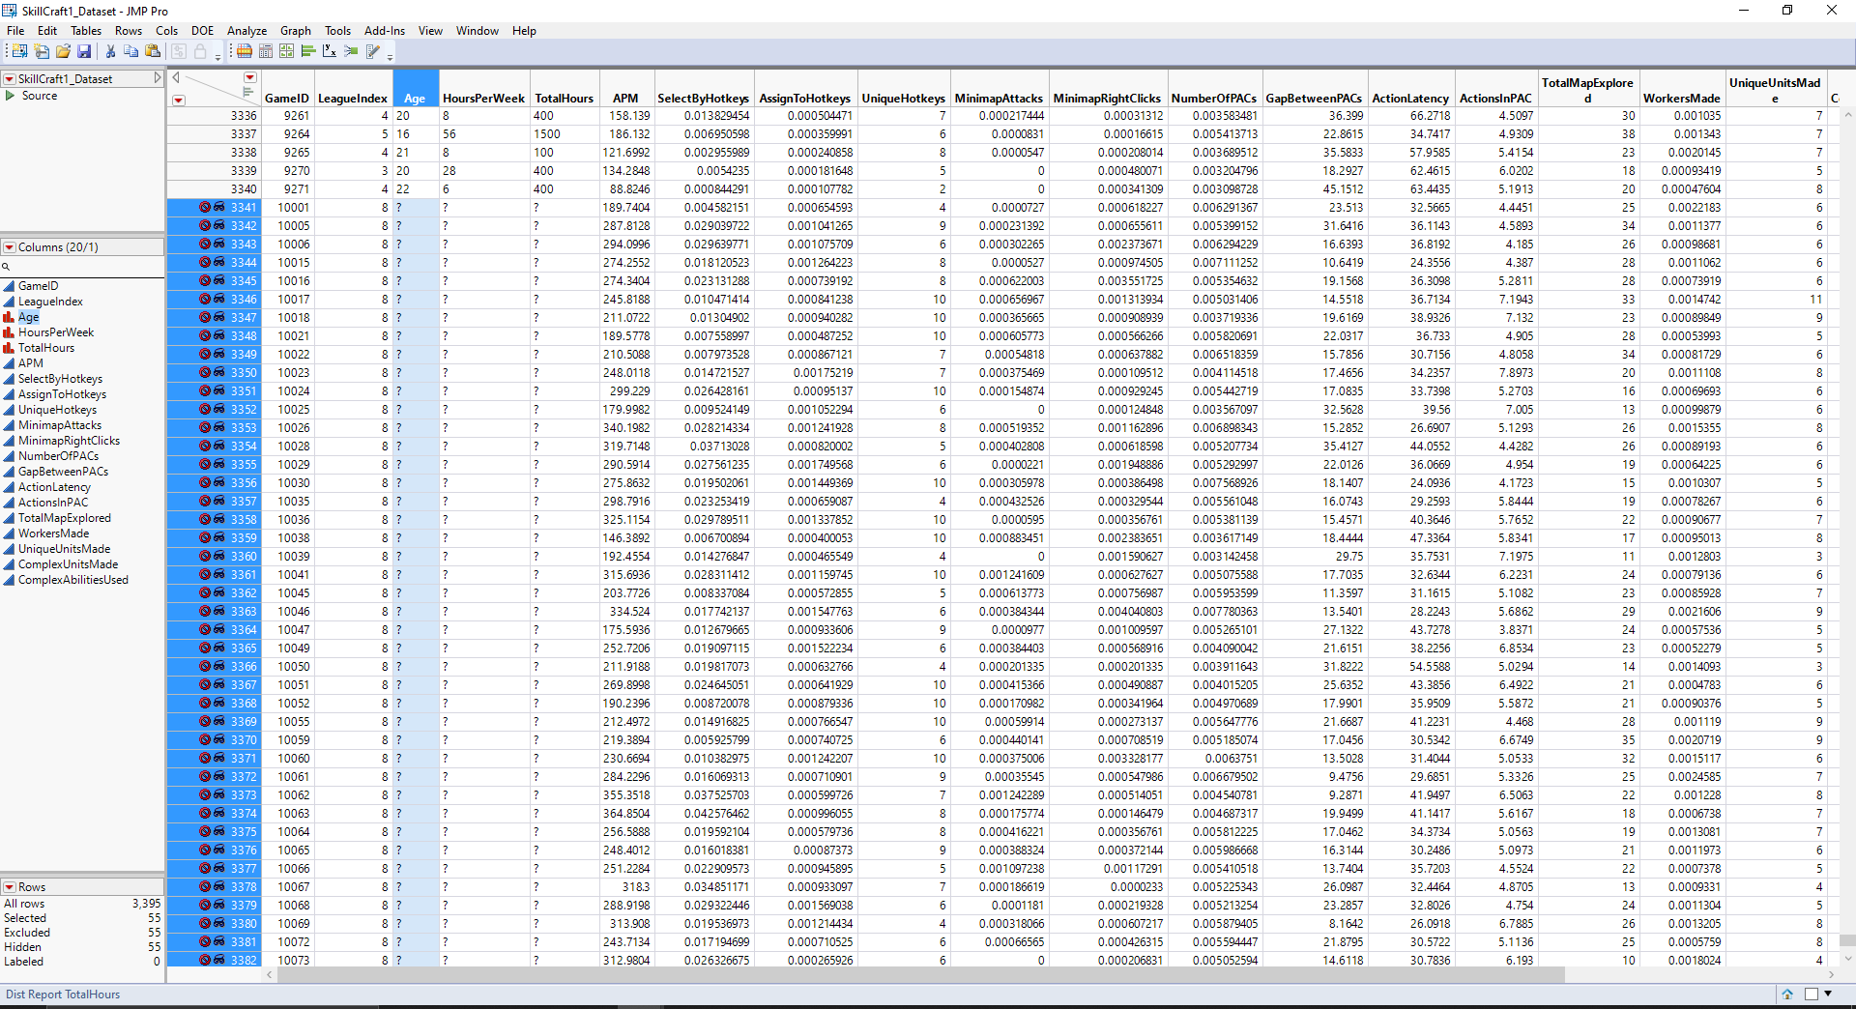
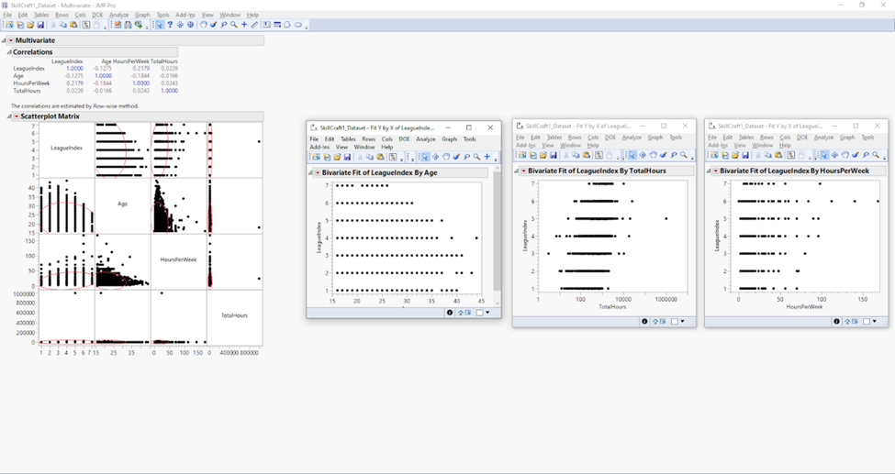
Missing Data
Missing values found in predictor variables: Age, HoursPerWeek and Total Hours
Relationship between these predictor variables and target variable were explored
Decision
Hide and exclude Age, HoursPerWeek and TotalHours
Notes:
What variables appear important?
What trends or patterns have you identified that are relevant to the business problem?
What interesting variable relationships have you discovered? Include visualizations to support your observations.

Slide 10
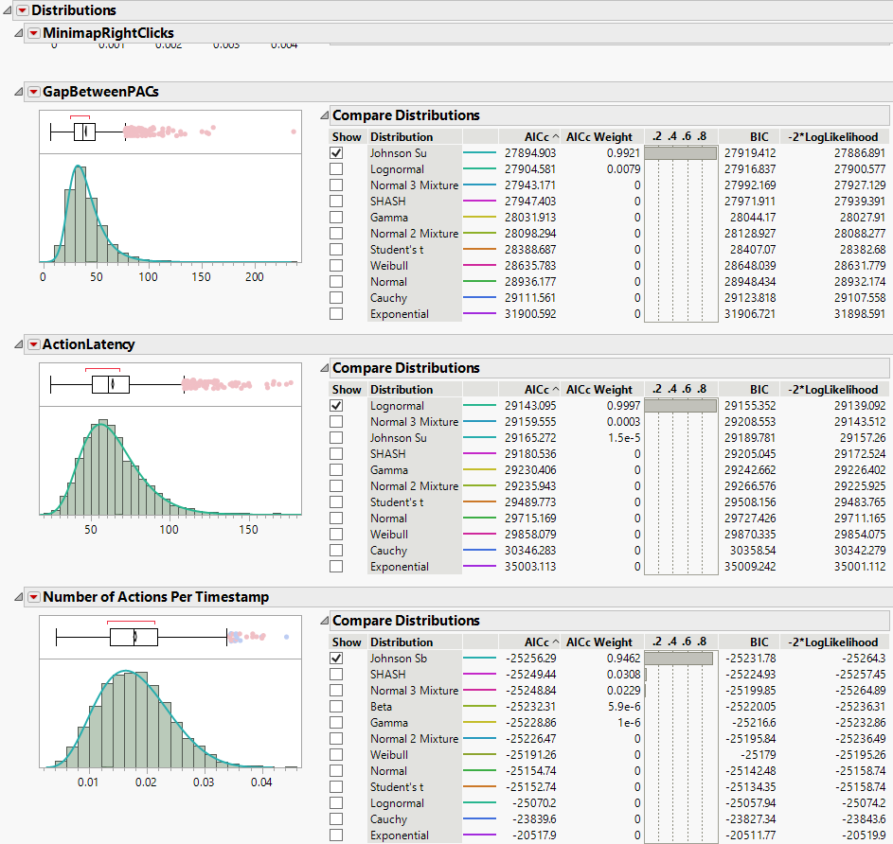
Outliers
Lot of outliers were identified across predictor variables
Highly skewed distributions
Exclusion of rows could lead to loss of information
Decision
Transformation of predictor variables
to scale data
Notes:
What variables appear important?
What trends or patterns have you identified that are relevant to the business problem?
What interesting variable relationships have you discovered? Include visualizations to support your observations.

Slide 11
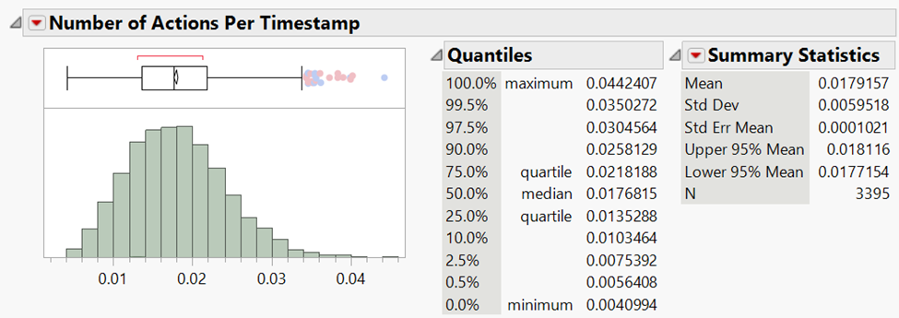
Reducing Dimensionality
Number of Actions Per Timestamp = Number of PACs x Actions in PACs
Decision
Introduction of interaction term to increase interpretability
Ensure predictor variables are measured per timestamp
Notes:
What variables appear important?
What trends or patterns have you identified that are relevant to the business problem?
What interesting variable relationships have you discovered? Include visualizations to support your observations.

Slide 12
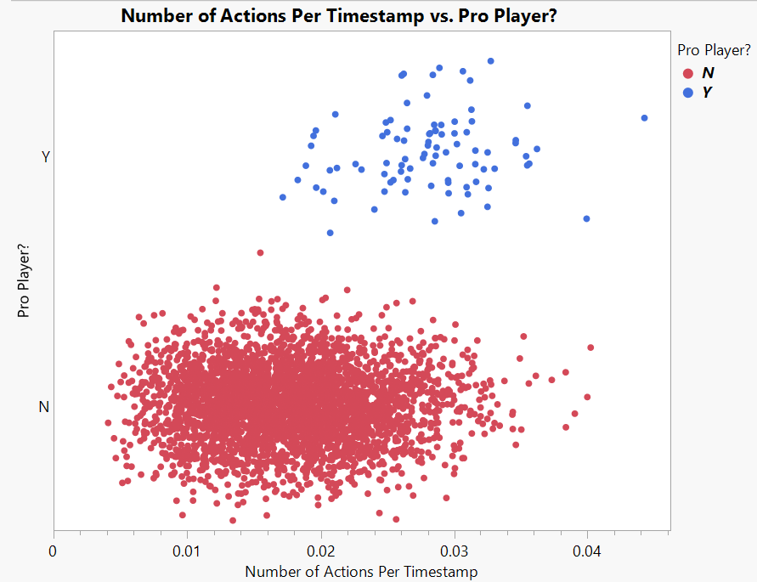
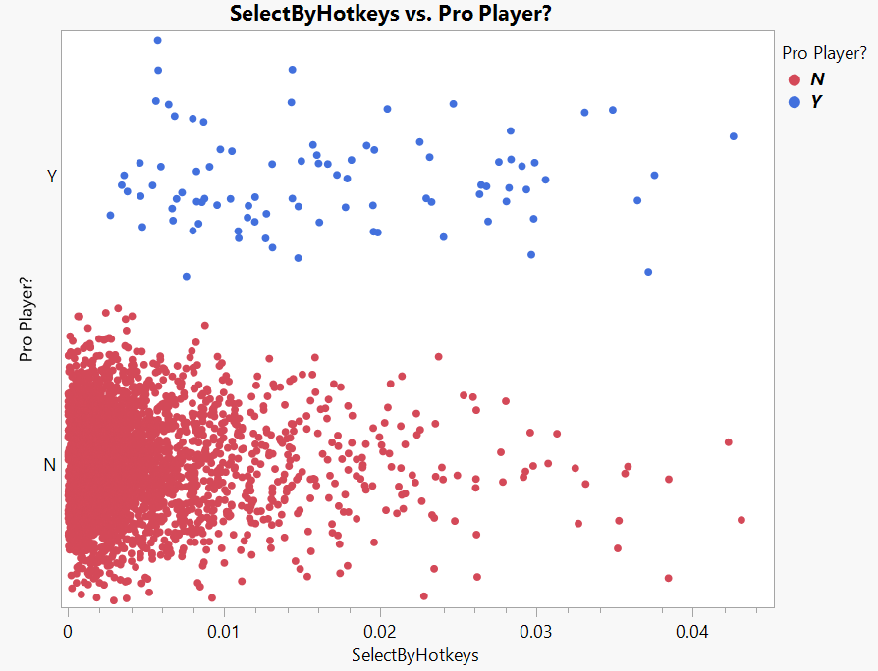
Significant Predictors - Correlation
Correlation between target and predictor variables were explored
Decision
Spread of data confirms some differentiation between target class
Notes:
What variables appear important?
What trends or patterns have you identified that are relevant to the business problem?
What interesting variable relationships have you discovered? Include visualizations to support your observations.

Slide 13
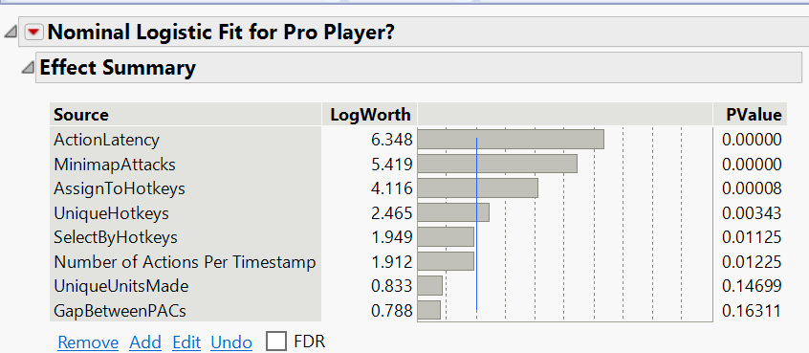
Significant Predictors
Selecting the most important variables
20 → 8

Slide 14
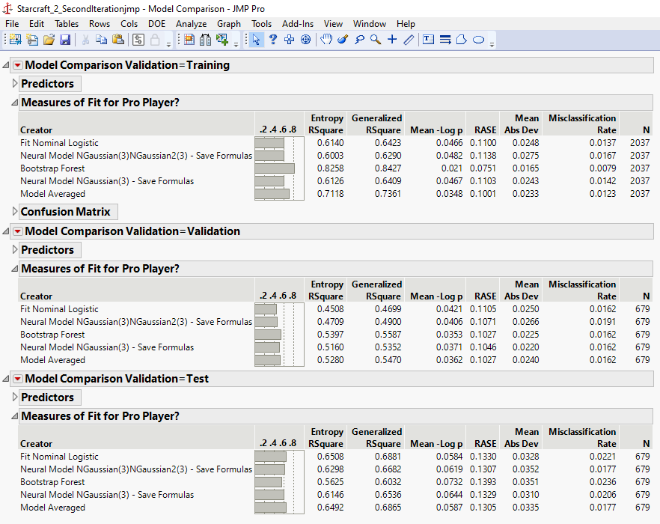







Comparing the best sets of models to predict our RARE (2.7%) class!
Predicting the Cream
Neural network
Logistic Regression
Bootstrap
Boosted
Discriminant
KNN
Ensemble models

Slide 15


Gaussian managing complex relationships between predictors & target
Deep Diving into the Best 2
Logit + Gaussian + Bootstrap Ensemble
Measures
2 layered Gaussian NN
Accuracy of 1
100%
89%
Sensitivity
48%
63%
Mis-classification rate
1.8%
1.8%
F1 score
74%
65%

Slide 16
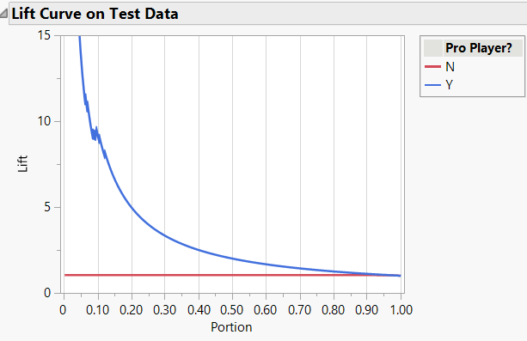
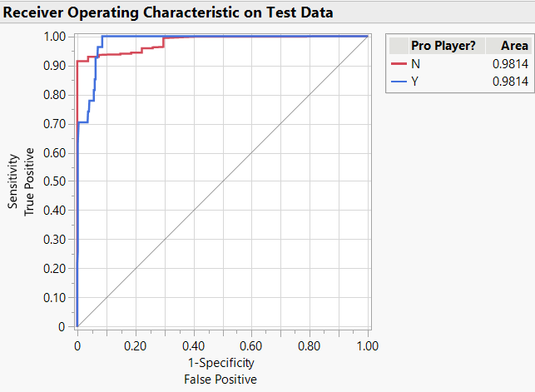
2 layered Gaussian NN Model!
Selecting NN meeting business requirement
Lift curve
AUC for ROC curve:
Our target class!
At 2.7% baseline, LIFT ~ 15
Response rate ~ 41%
AUC 98%
Notes:
We have used test data for all above performance variables

Slide 17

Over sampling: Model overfits to training & validation
Tuning the model to better determine the rare event
Notes:
Over sampling leads to better the performance for both training and validation but leads to reducing the accuracy drastically on test owing to high degree of overfitting the data to training and validation!

Slide 18
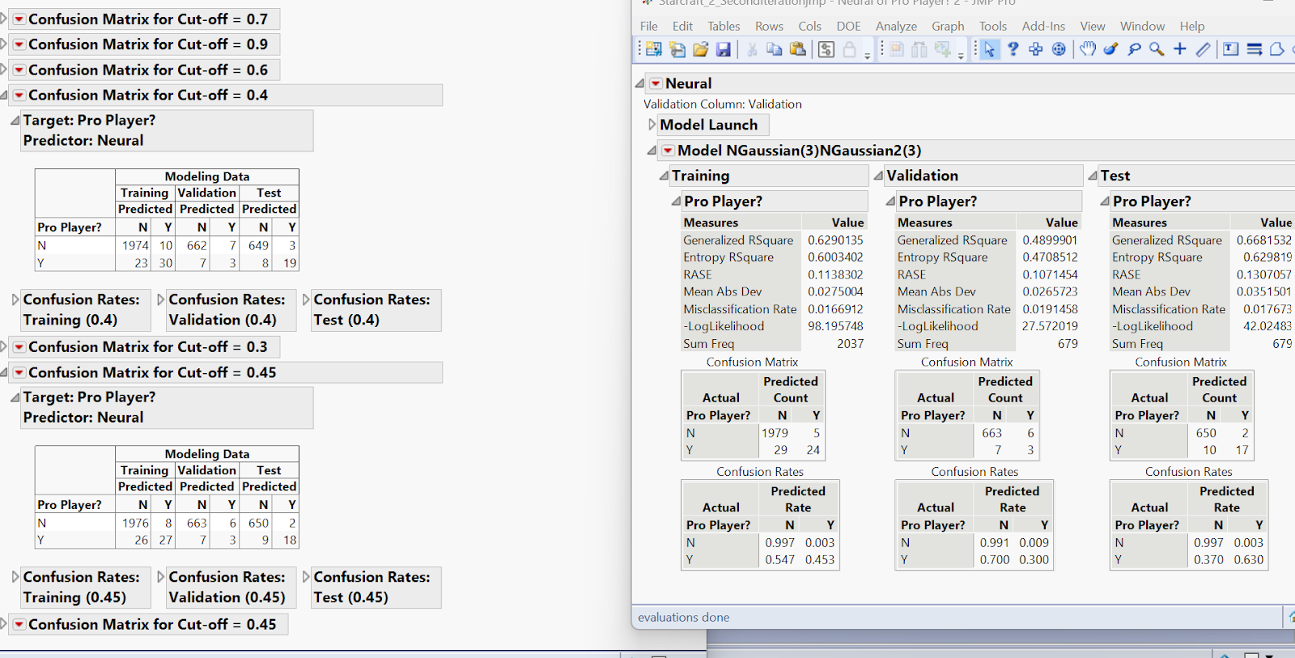

Determining the optimal cut – off!
Modulating for the best prediction
Notes:
We tried a variety of cut-offs and finally closed with 0.4 that could predict our rare event accurately and as high as possible!

Slide 19
OPTIMAL -> 2 layered 3 node Gaussian + 0.4 cut off
Closing with the Best Model
Accuracy of 1: 86%
Sensitivity: 70%
Complexity: HIGH
Overall Accuracy: 98.4%

Slide 20
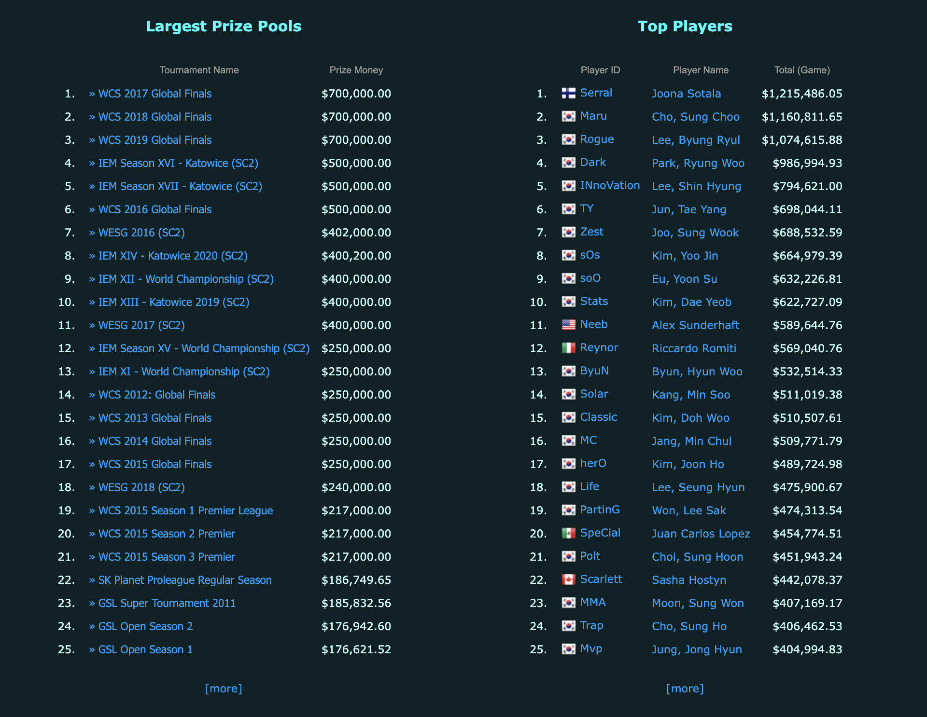
Business Recommendations
Identifying Potential Elite Players and Recruiting
01
Invest in Training and Development of Players
02
Optimizing Talent Management Efforts
03

Slide 21
References
References for data, information and images used in the presentation are as below:
Data source: https://data.world/scuttlemonkey/starcraft-2-skillcraft-1
https://starcraft2.com/en-us/media#screenshots-1
https://www.youtube.com/watch?v=3frQjtyogMs
https://www.youtube.com/watch?v=7YFENdjm5Lw
https://www.forbes.com/sites/brettknight/2022/05/06/the-most-valuable-esports-companies-2022/?sh=431072d1599f
https://www.esportsearnings.com/games/151-starcraft-ii
https://news.blizzard.com/en-gb/starcraft2/13235353/winner-takes-all-iem-world-championship
https://www.beyondgames.biz/32134/the-future-of-esports-growth/#:~:text=The%20esports%20market%20is%20estimated,events%20and%20new%20platform%20launches.

Slide 22
“The work contained and presented here is our work and our work alone.”

Slide 23
Appendix

Slide 24
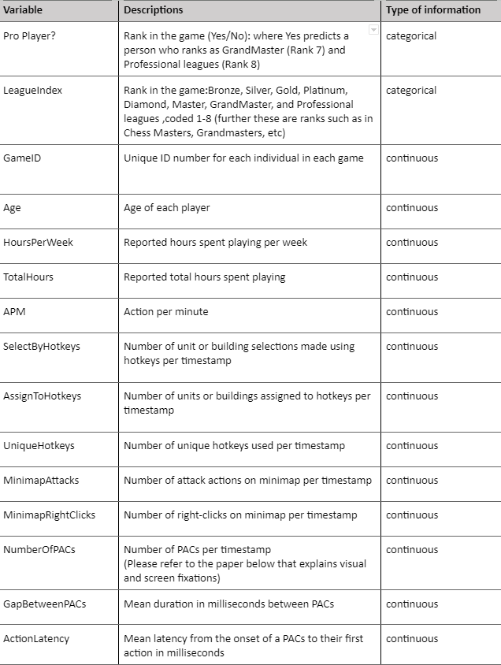
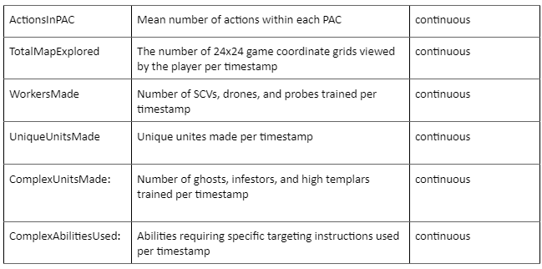
Eyeballing the Data Set
“Pro Player? “ is the target variable for this data set
Eyeballing the data set, defining the target variable, and checking the data type for each variable

Slide 25
Data Pre-processing: Reducing Dimensionality
Reducing row dimensionality: As all our data rows contained individual player details, we wanted to use the complete data set and avoid any sampling to be done on the same. Hence, apart from excluding the missing data rows, we have used the complete data set
Reducing column dimensionality: We reduced the complexity of our columns by determining the important predictors using data exploration and running a few models. The log worth was examined to find predictors with high degree of importance to train the model using the same and make predictions.
By addressing column dimensionality, we have improved the overall prediction of target class drastically. The target variable’s categories have been reduced to 2 to minimize the complexity.

Slide 26
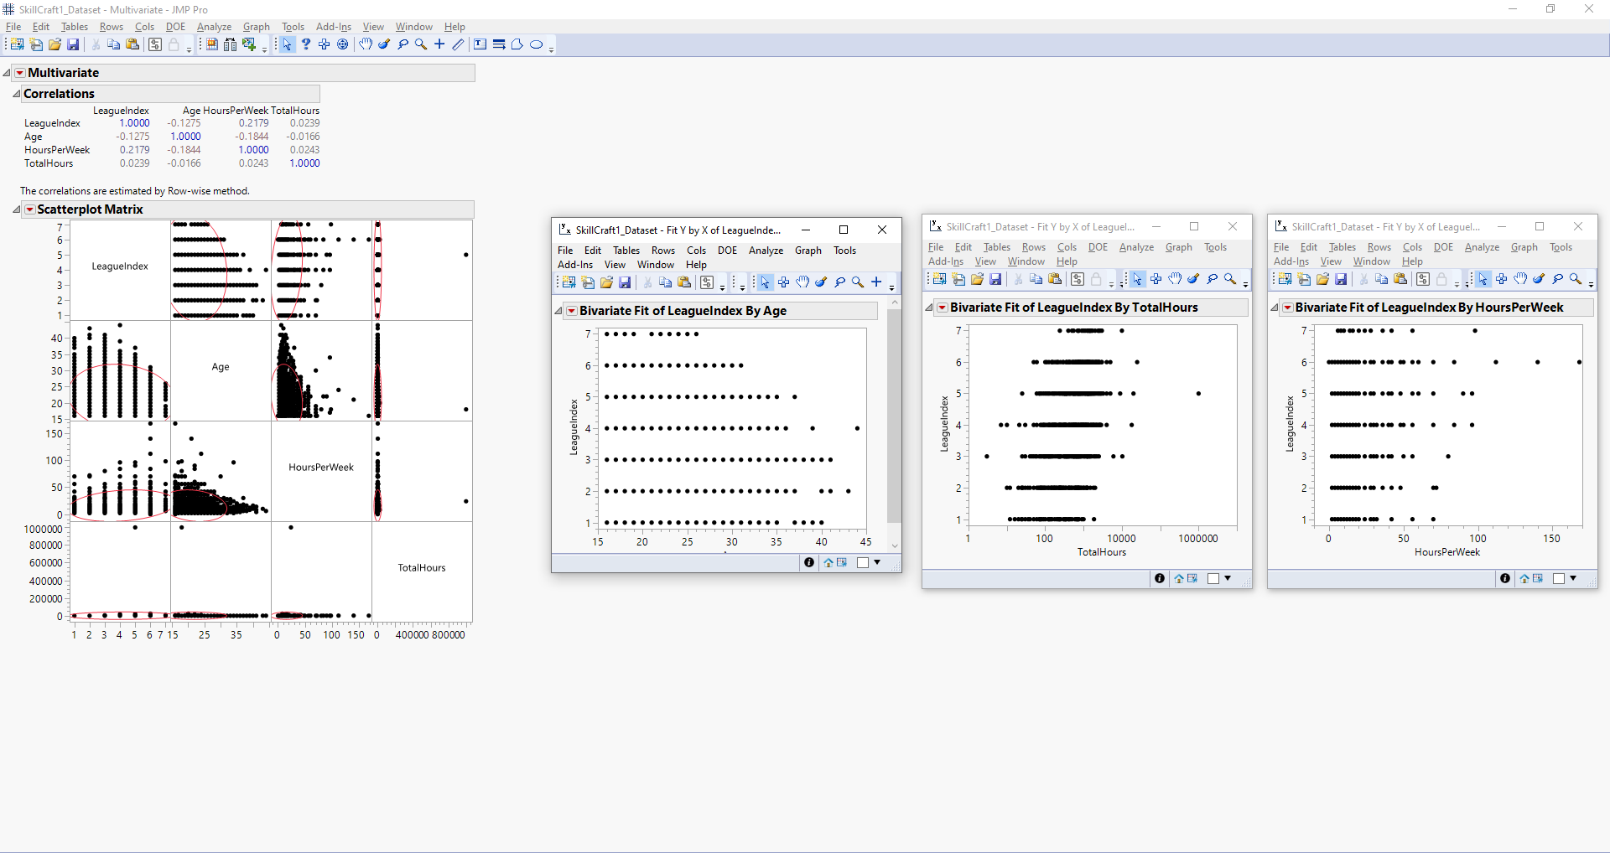
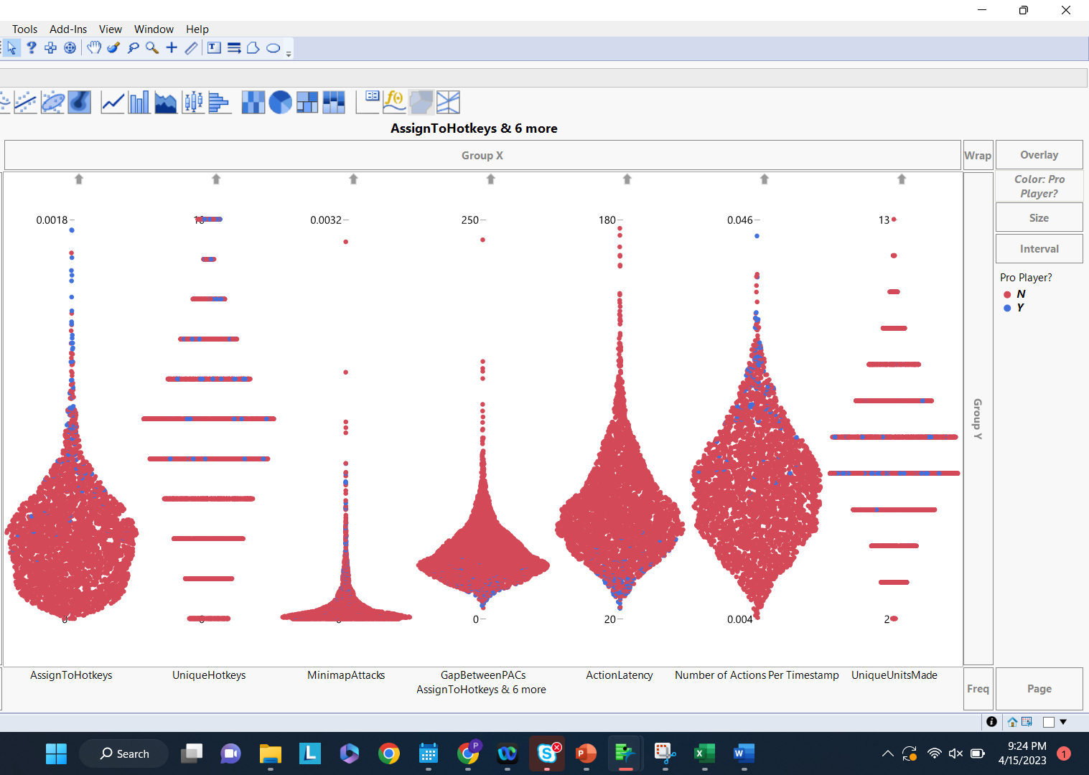
Data Exploration: Correlations
Visual representations have formed major part of our exploration (checking correlation of predictors to target)
Checking correlations between our predictor variables and target variable

Slide 27
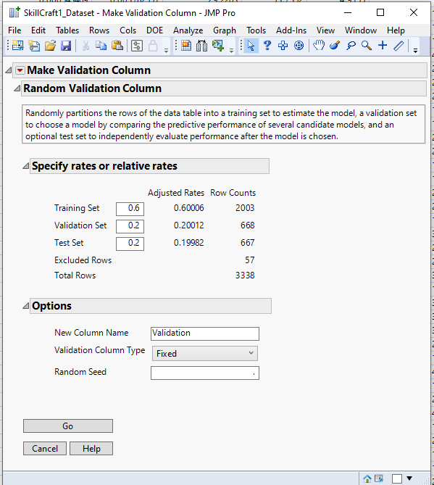
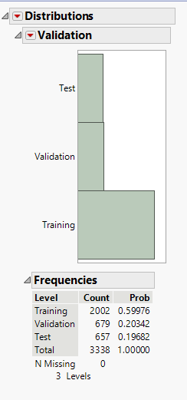
Data Partition
Dataset was partitioned into 3 sections: Training, Validation and Test
The weightage for the 3 partitions are as follows:
Training - 60%
Validation - 20%
Test - 20%
Partitioning the data to get it ready to model

Slide 28
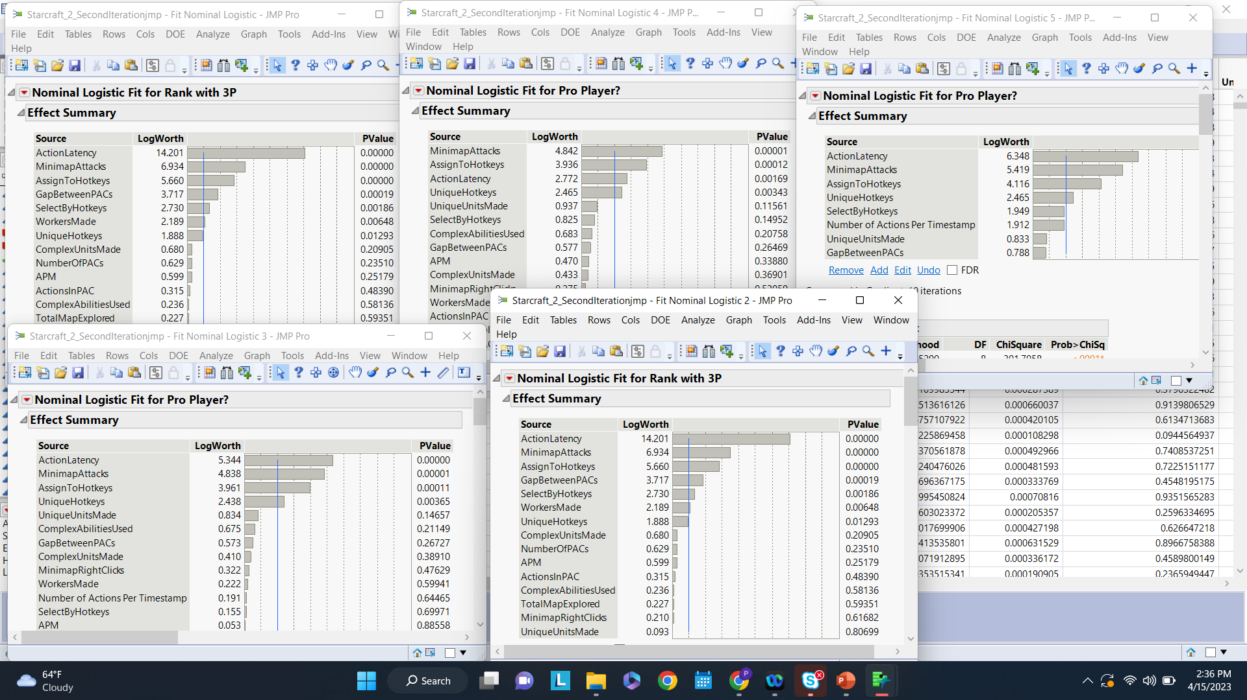
Modeling - Different types and comparison
Model 2:
Model 3:
Model 1:
Selecting the predictor variables
Model 4:
Model 5:
We ran logistic regression to determine our key variables. Through above 5 different models, we could conclude on selecting 8 variables out of 20 that had the highest log worth.

Slide 29
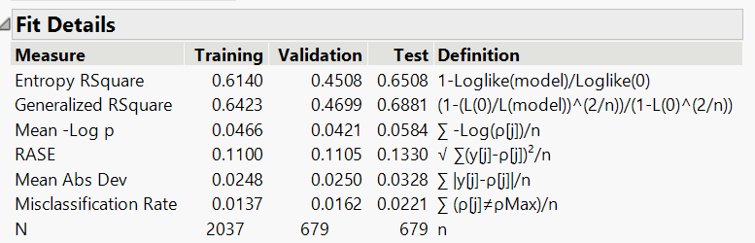
Modeling - Different types and comparison
Variable | Selection
GameID
LeagueIndex
Age
HoursPerWeek
TotalHours
APM
SelectByHotkeys | Yes
AssignToHotkeys | Yes
UniqueHotkeys | Yes
MinimapAttacks | Yes
MinimapRightClicks
NumberOfPACs
GapBetweenPACs | Yes
ActionLatency | Yes
ActionsInPAC
No. of actions per time stamp | Yes
AggregatedlActionsin PAC
TotalMapExplored
WorkersMade
UniqueUnitsMade | Yes
Results of Logit model
The above image shows the 8 key variables finalized along with the logistic regression model pruned with those 8 key variables

Slide 30
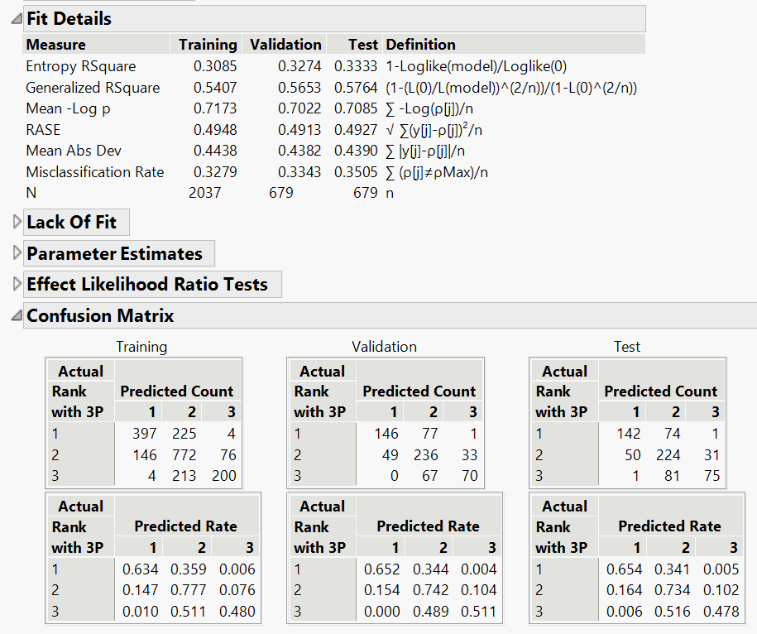
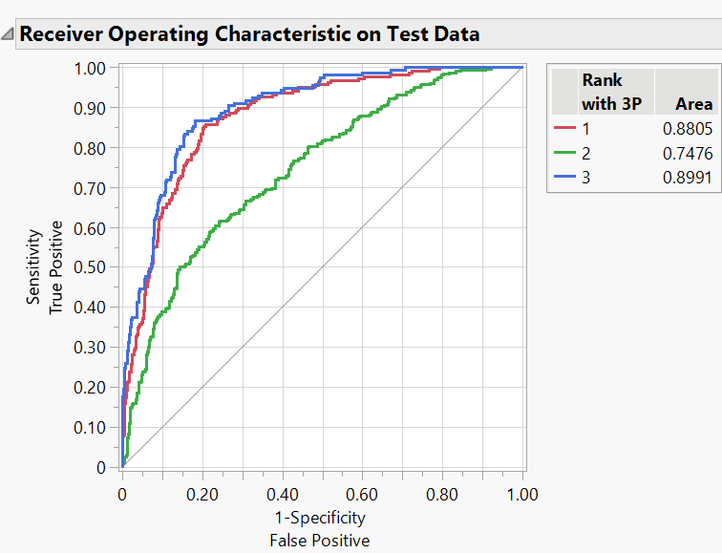
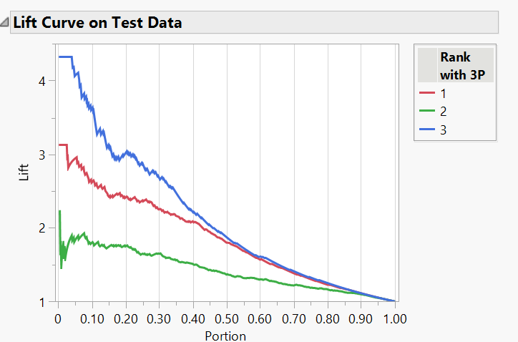
Model 0 - Logit Model (No Transform)
This logit model was run with the target variable having 3 categories. It led to a misclassification rate of 0.3505

Slide 31
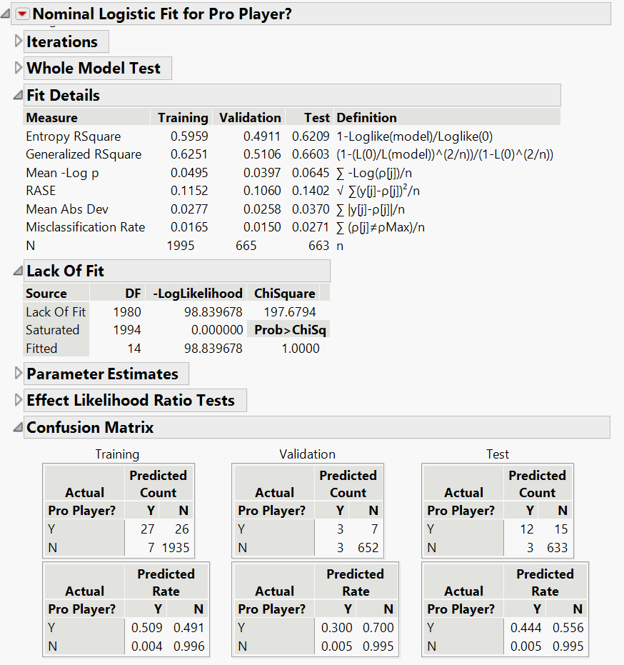
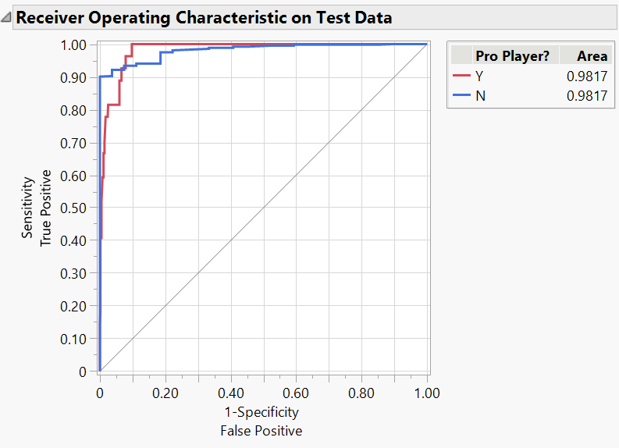
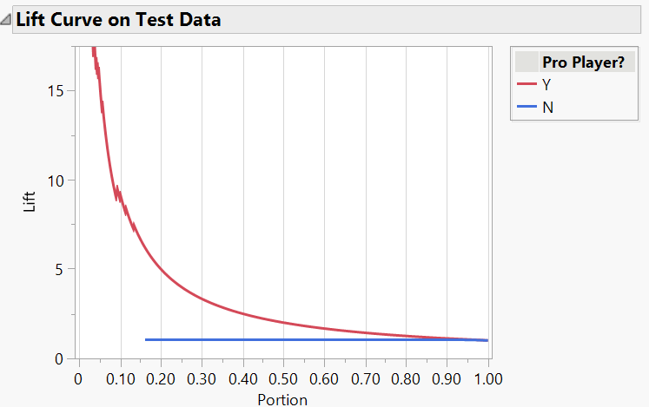
Model 1 - Logit (Transform, Interaction Term)
This is an iteration of a logit model with transformed predictor variables to account for outliers and an interaction term
From Model 1 onwards, all models were run with the target variable having 2 categories (Ref Slide 13)

Slide 32
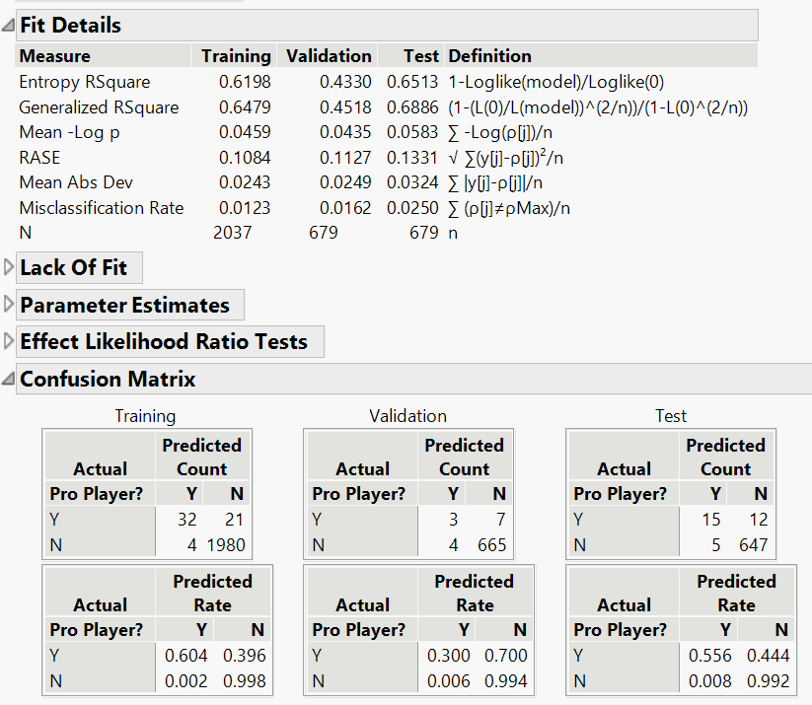
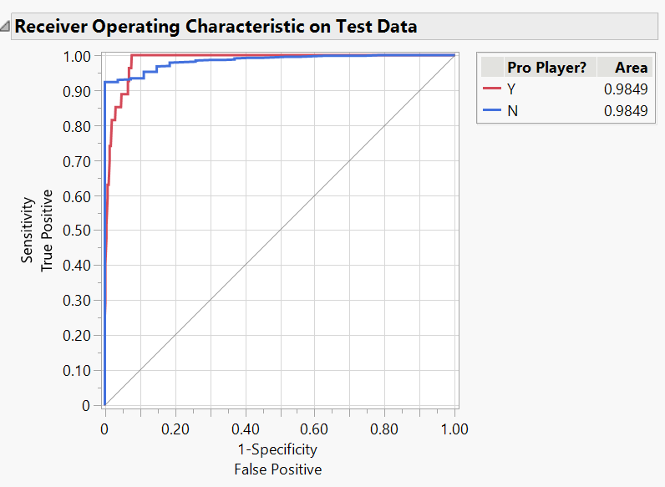
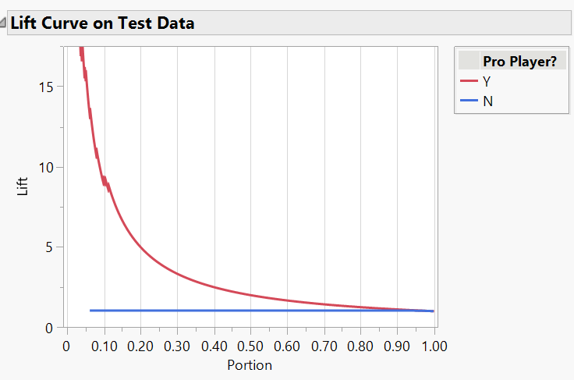
Model 2 - Logit (No Transform, Interaction Term)
This is an iteration of a logit model with no transformations and an interaction term. The misclassification rate is at 0.0250

Slide 33
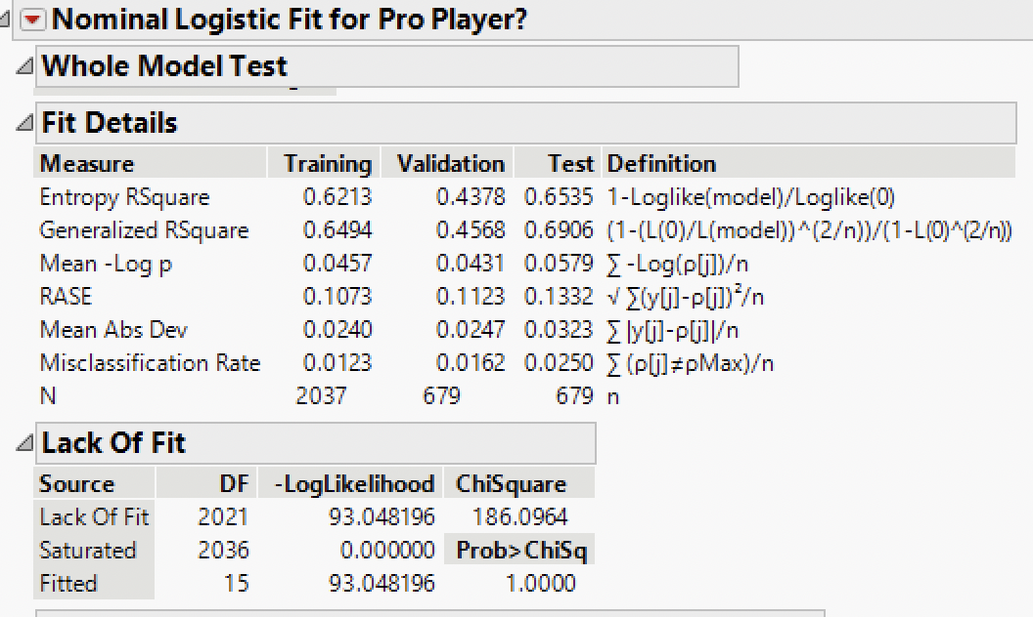
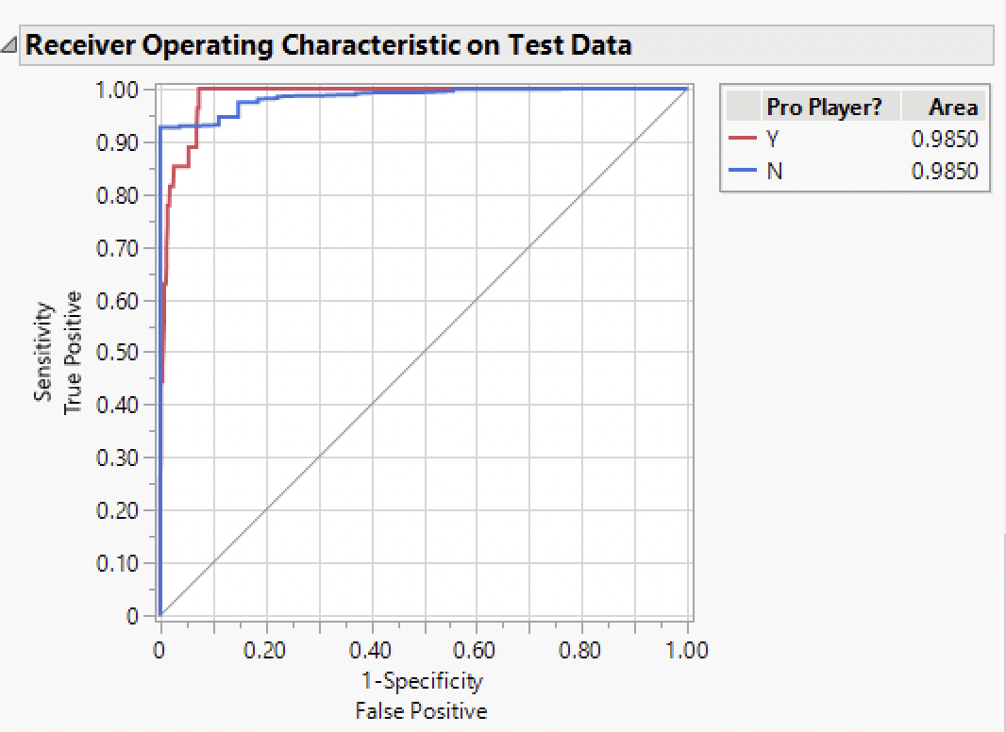
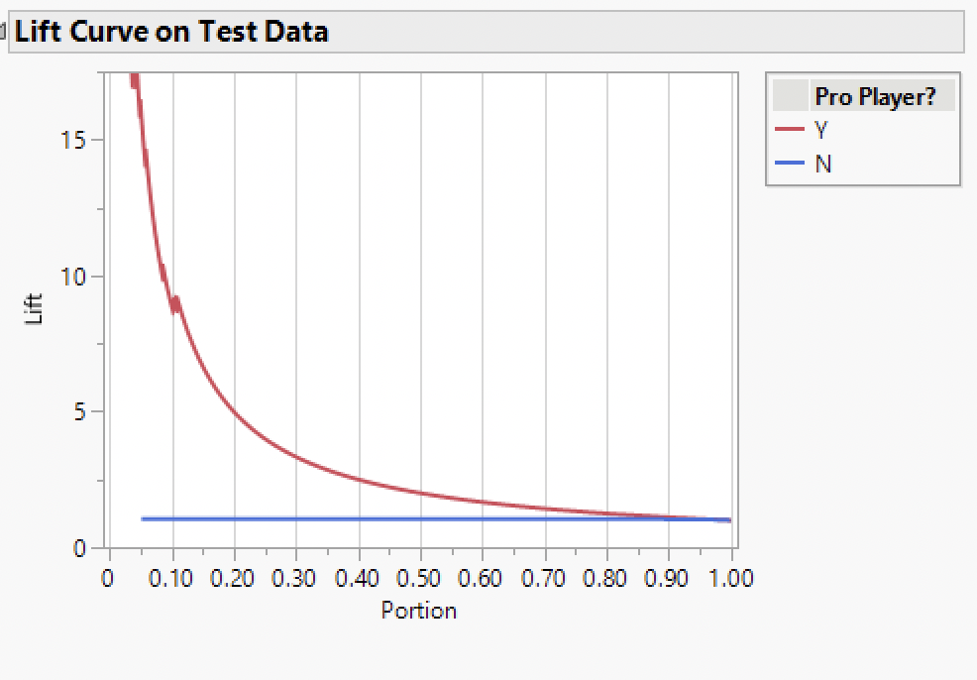
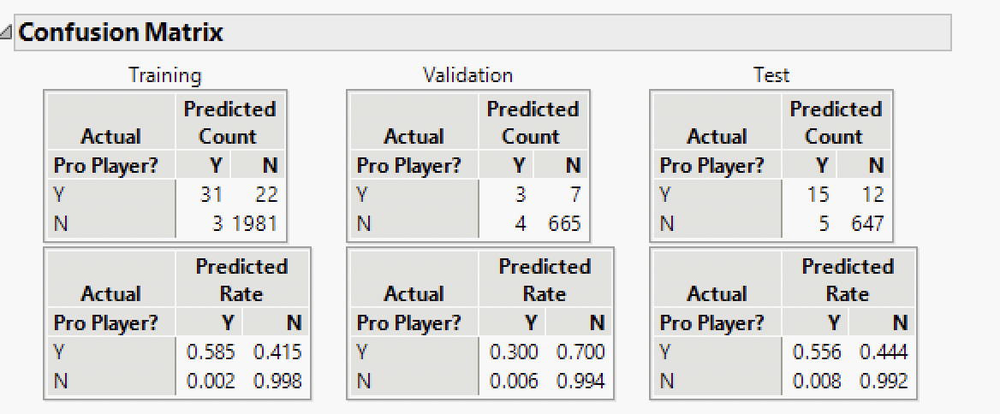
Model 3 - Logit (No Transform,No Interaction Term)
This is an iteration of a logit model with no transformation and no interaction term. The misclassification rate is at 0.0250

Slide 34
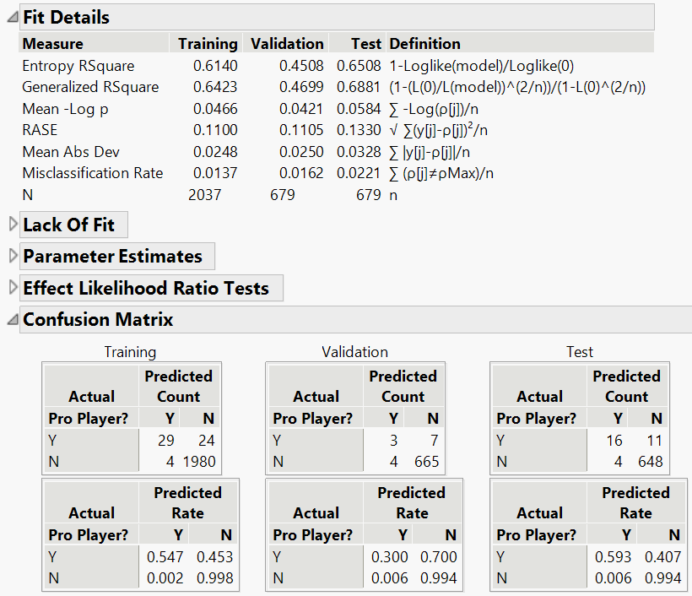
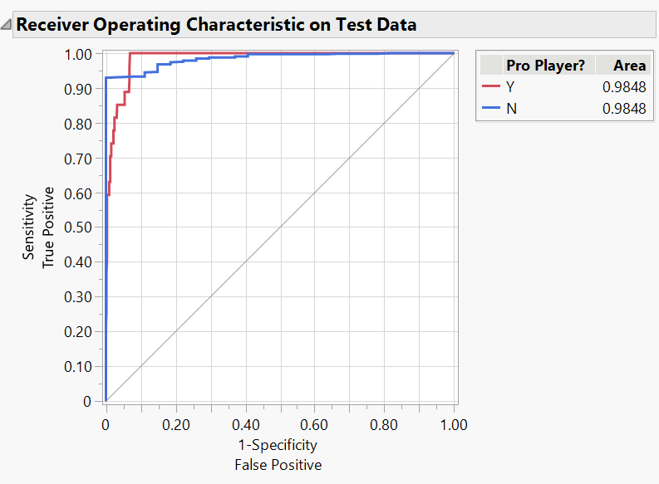
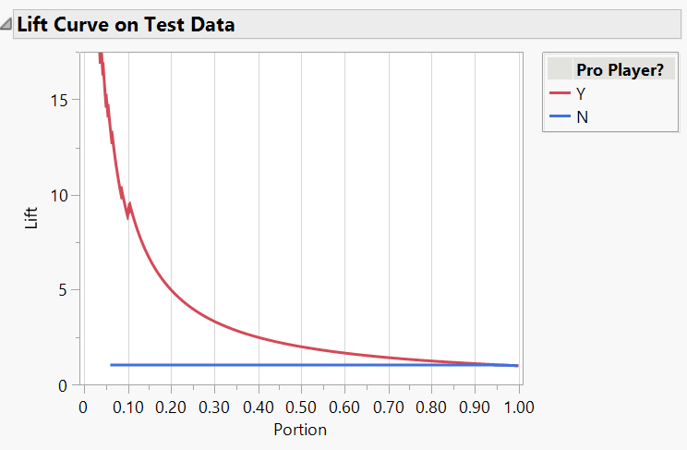
Model 4 - Logit (No Transform,Interaction term)
This is an iteration of Model 2 with only 8 predictor variables. The misclassification rate is at 0.0221

Slide 35
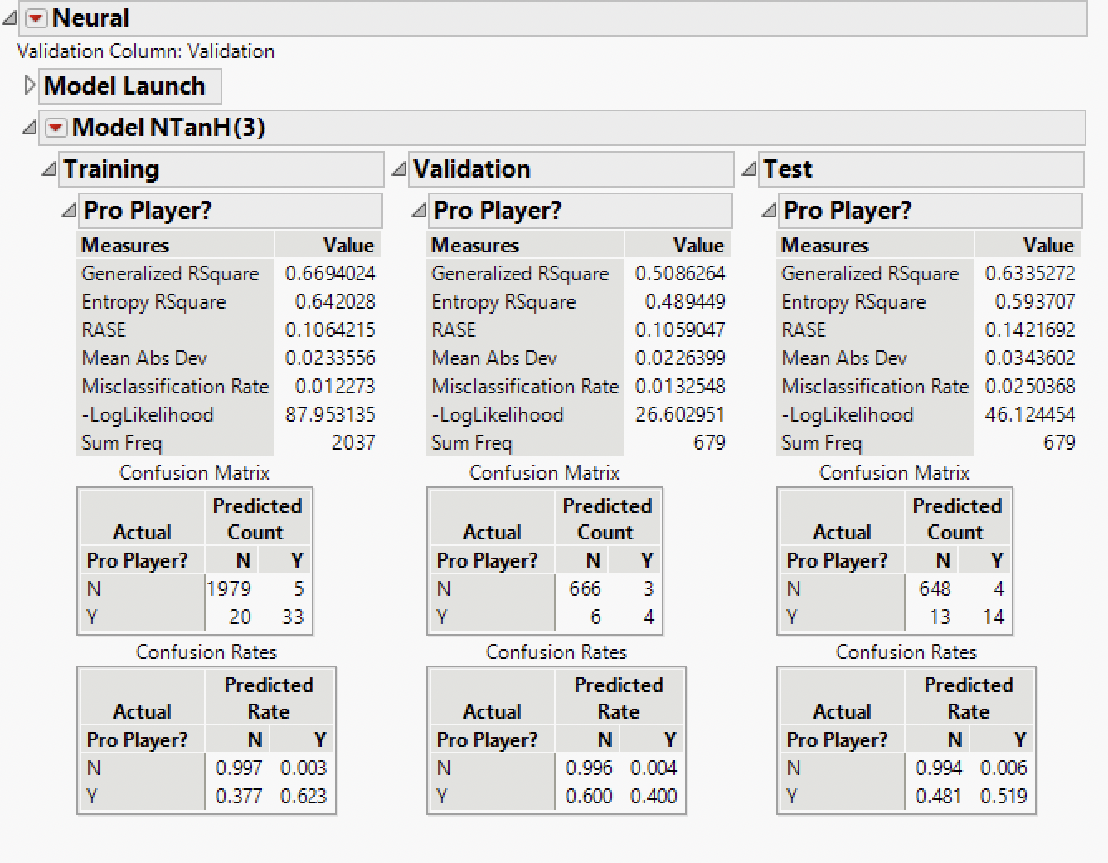
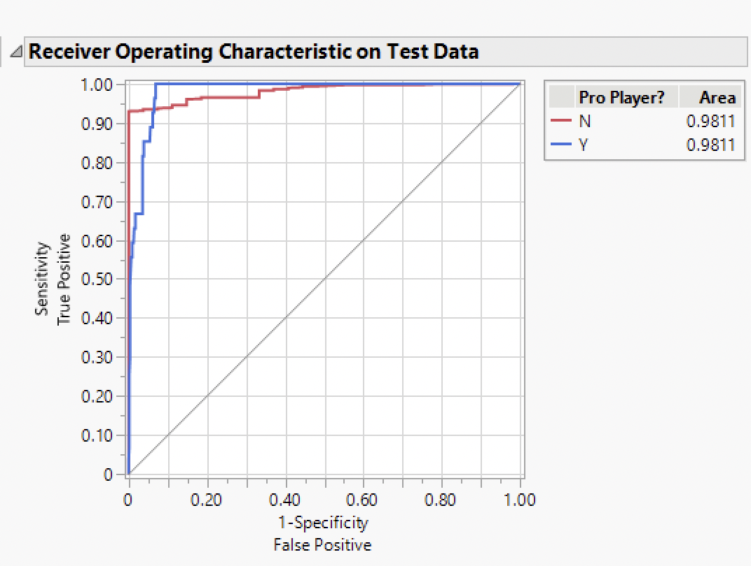
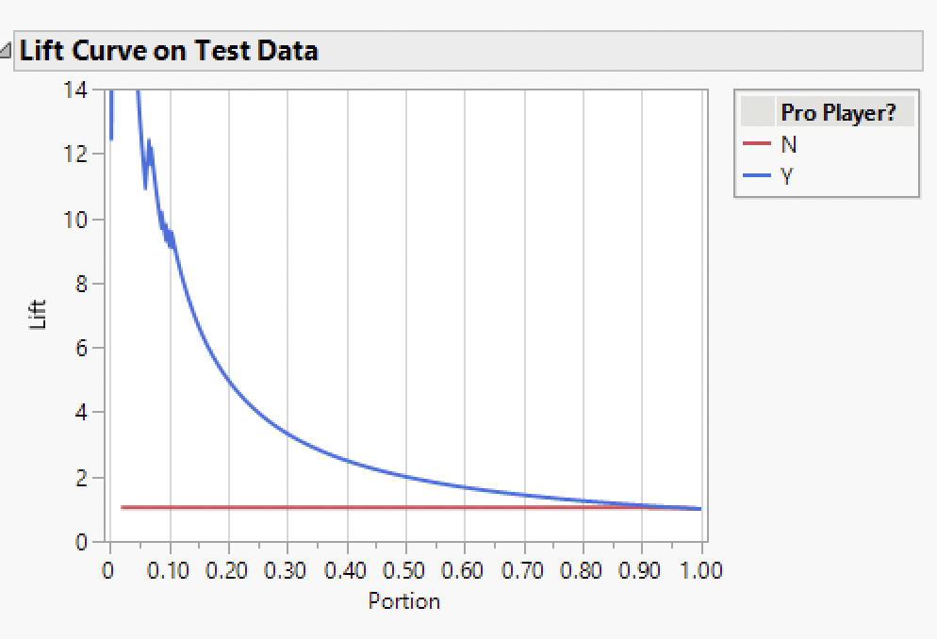
Model 5 - Neural Network TanH(3)
This is a neural network model with 3 TanH nodes. The misclassification rate is at 0.0250.

Slide 36
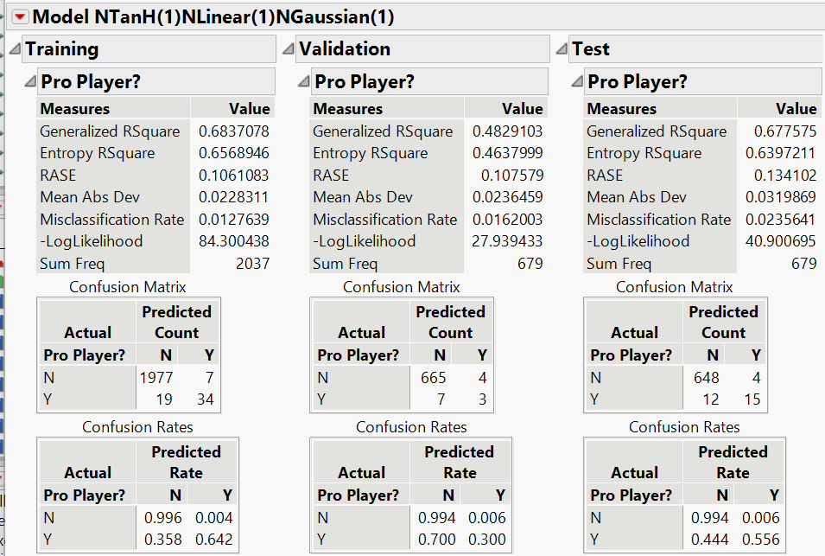
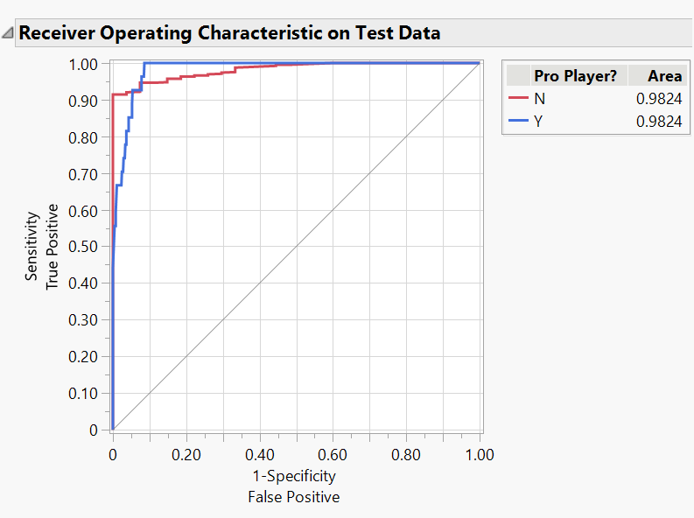
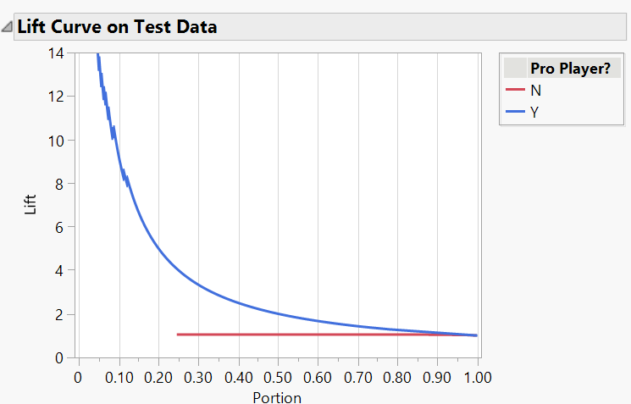
Model 6 - Neural Network TanH(1)L(1)G(1)
This is a neural network with 1 TanH node, 1 Linear node, and 1 Gaussian node. The misclassification rate is 0.0236.

Slide 37
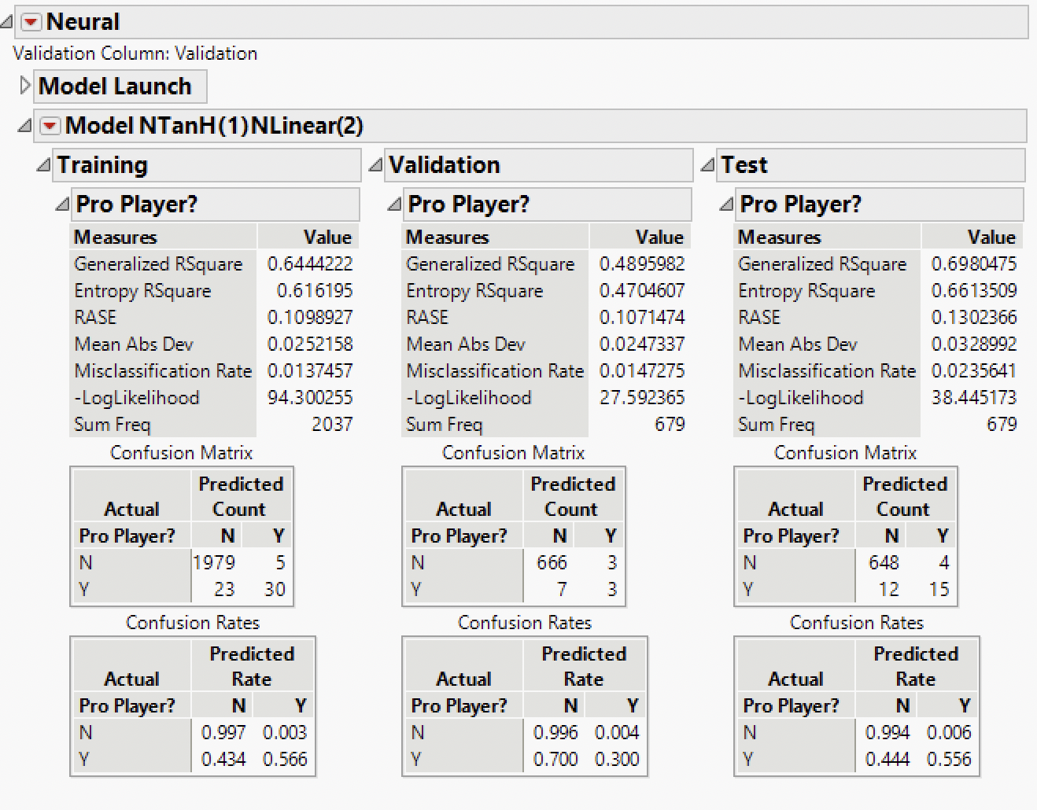
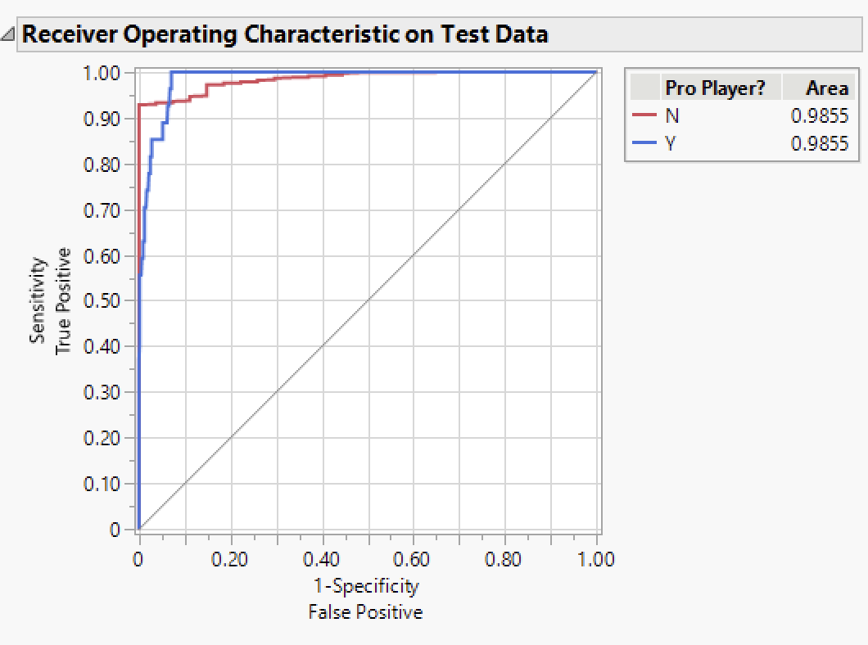
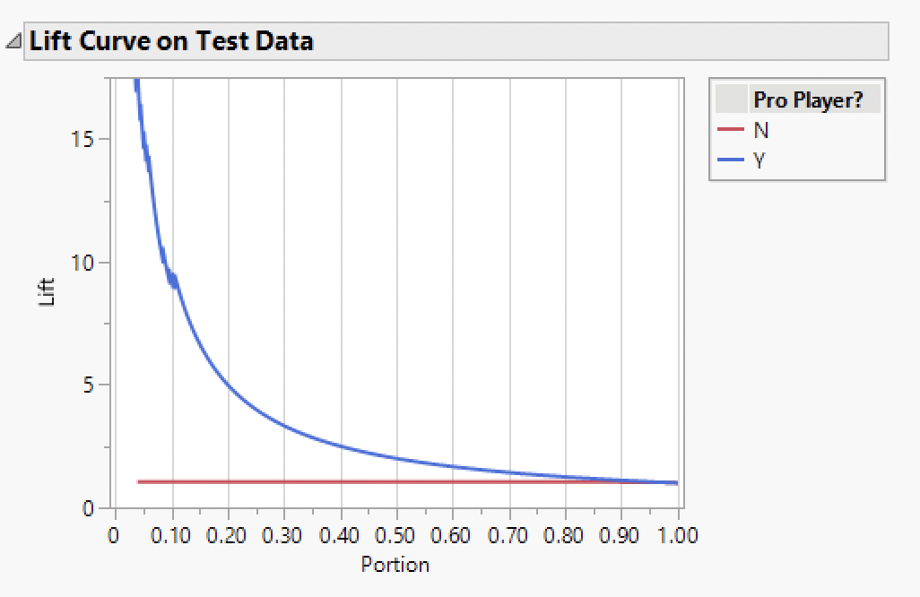
Model 7 - Neural NTanh(1)Linear(2)
This is a neural network with 1 TanH node, and 2 Linear nodes. The misclassification rate is 0.0236.

Slide 38
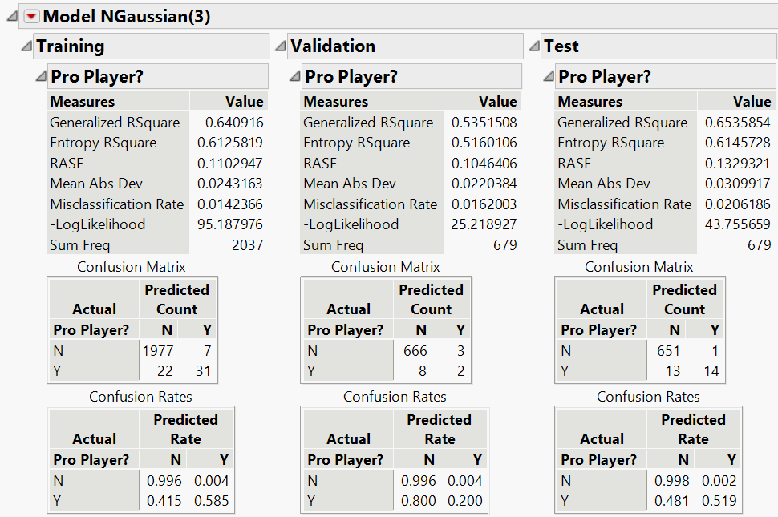


Model 8 - Neural Network G(3)
This is a neural network with 3 Gaussian nodes and 1 hidden layer. The misclassification rate is at 0.0206

Slide 39


Model 9 - Neural Network G(3)G(3)
This a neural network with 2 hidden layers of 3 Gaussian nodes. The misclassification rate is 0.018.

Slide 40


Model 10 - Naive Bayes
This is a Naive Bayes model. The misclassification rate is 0.065.

Slide 41




Model 11 - Decision Tree (UnPruned)
This is an unpruned decision tree model. The misclassification rate 0.039.

Slide 42




Model 12 - Decision Tree (Pruned)
This is a decision tree model with 4 splits. The misclassification rate is at 0.0339.

Slide 43


Model 13 - Boosted Tree
This is a boosted tree model. The misclassification rate is 0.0295.

Slide 44


Model 14 - Bootstrap Tree
This is a bootstrap tree model. The misclassification rate is 0.0236.

Slide 45


Model 15 - K-NN
This is a K-NN model with a sensitivity rate of 0.026 on test partition.

Slide 46


Model 16 - Discriminant Analysis
This is a Discriminant Analysis with a misclassification rate of 8.84% on test partition.

Slide 47




Model 17: Ensemble 1 - NN1,Bootstrap
This is an Ensemble Model combining Model 9 and Model 14. This model has a misclassification rate at 0.0206.

Slide 48






Model 18: Ensemble 2 - NN1, NN2, Bootstrap, Logit
This is the second Ensemble model which combines Model 4, Model 8, Model 9 and Model 14. The misclassification rate is at 0.0177.

